Slide 1

E-commerce Store Sales Report Overview
This report summarizes sales, customer activity, and global reach from 2023 to 2025.
It offers insights into trends, category performance, payment methods, and order status.
by Anurag Sharma

Slide 2
Key Metrics Summary
Total Orders
Average Revenue per Order
Total Customers
200 orders processed
$2,150 per order
100 active customers
Stock Quantity Remaining
Total Revenue by Year
Only 50 items left in inventory
$360,750 earned in total

Slide 3
Category-wise Performance
Quantity Sold by Category
Toys lead in quantity sold
Home & Kitchen, Electronics, Clothing follow
Books show lowest sales, possible limited promotion
Price Distribution by Category
Toys and Home & Kitchen each 24%
Balanced price spread overall
Books at 16%, indicating smaller product range

Slide 4
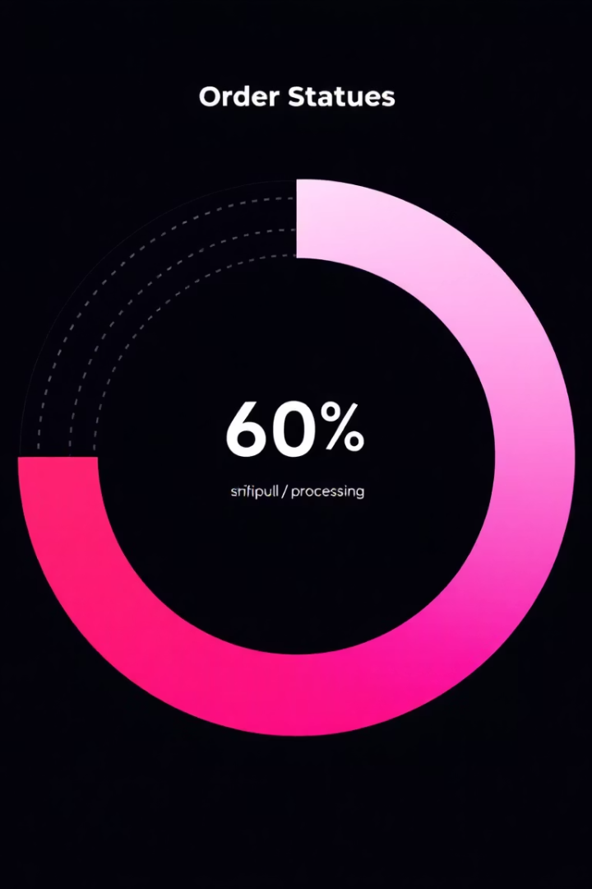
Order Status Insights
Shipped Orders
Processing Orders
36.5% of orders delivered successfully (73 total)
34% still in process, highlighting potential fulfillment delays
Cancelled Orders
29.5%, a significant share that requires investigation

Slide 5



Payment Method Preferences
PayPal
2
Close second with 34%
Bank Transfer
1
Most popular at 36%
3
Credit Card
Still widely used at 30%
Maintaining all three payment options meets diverse customer preferences and convenience.

Slide 6
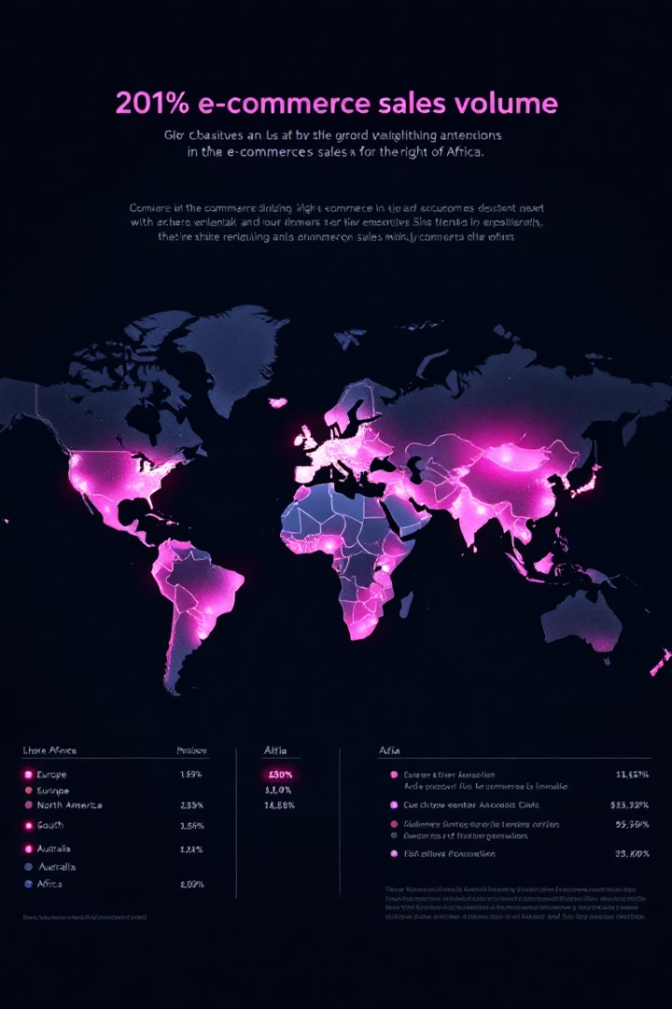
Geographic Sales Distribution
High Sales Regions
Europe, North & South America, Australia lead sales volume
Opportunity Areas
Asia and Africa show moderate to low sales, ripe for growth campaigns

Slide 7
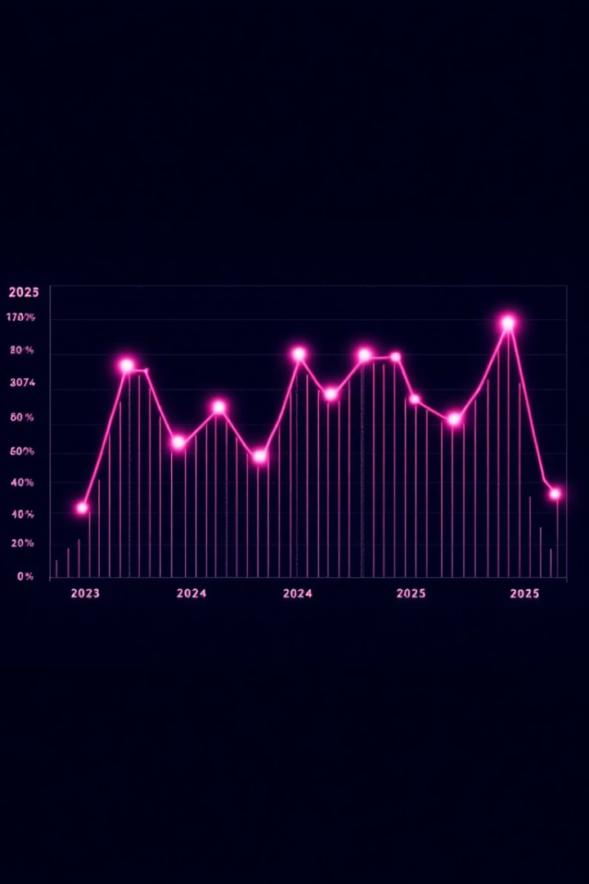
Yearly Order Trends
2023
Low order volume gains initial footing
2024
Sharp increase marks peak sales year
2025
Noticeable decline; marketing, competition, or quality issues suspected

Slide 8

Conclusion: Performance & Challenges
Strengths
Challenges
Regional Focus
Strong 2024 sales, balanced product mix, popular payment methods
2025 order decline, 29.5% cancellations, low inventory at 50 items
Europe and Americas engage most; Asia/Africa need targeted strategies

Slide 9





Recommendations to Drive Growth
Analyze Cancellations
Identify causes and deploy solutions to reduce losses
Improve Fulfillment
Accelerate processing to enhance order satisfaction
Restock Inventory
Prevent sales limitations by replenishing stock and expanding line
Expand Market Reach
Invest in marketing campaigns for Asia and Africa
Monitor & Adjust
Track 2025 trends closely and react to revive sales

